Slide 1

Optimizing Airbnb Ratings: Predictive Analytics on Property Features
Group 2
Rahul Sadineni (RXS230051)
Tajagna Parikh (TPK180000)
Bhoomi Parikh (BBP240001)
Aakanksha Bhat (DAL241941)
Akshay Gada (DAL873737)
Atharva Nalawade (DAL679819)

Slide 2
Table Of Contents
Feature Selection Strategy
Data Preprocessing
Exploratory Data Analysis
Machine Learning Models
Results and Model Comparison
Conclusion & Strategic Takeaways
Data Overview

Slide 3
Data Overview
Understanding the Airbnb Dataset
The data consists of 12800 Airbnb's around the world.
Number of Rows: 12800
Number of Columns: 23
Dataset includes thousands of Airbnb listings with features like: rating, reviews, price, bedrooms, bathrooms, guests, and more.
Objective: Predict if a listing will receive a high rating (≥ 4.9).
Target variable created: high_rating (binary: low or high).

Slide 4
Feature Selection Strategy
Selected features based on intuition, correlation, and completeness:
reviews (number of reviews)
price (transformed)
bathrooms, beds, bedrooms, guests
Target variable: high_rating created from numeric transformation of rating.
Features with high missing values or irrelevant to ratings were removed.
Focused only on numeric features to simplify modeling.

Slide 5
Data Preprocessing
Converted text-based rating to numeric; replaced "New" with NA.
Created binary target: high (≥ 4.9), low (< 4.9).
Removed NA values and outliers for robust modeling.
Applied log transformation to price to fix right skewness.
Cleaned review values and capped extreme outliers for EDA visualizations.

Slide 6
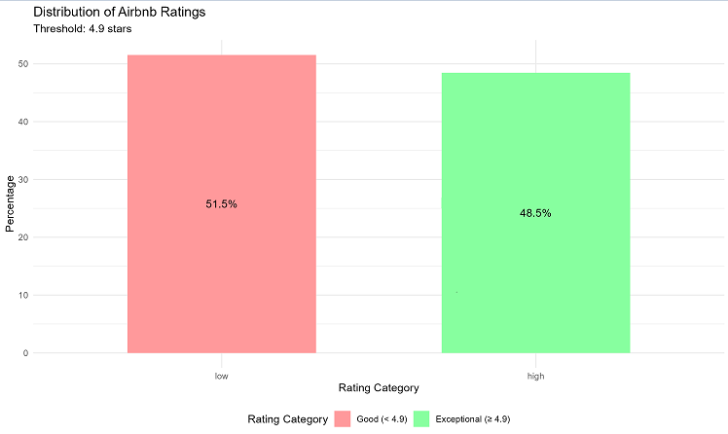
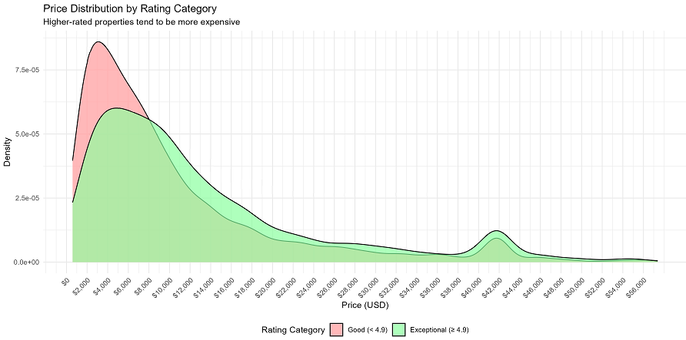
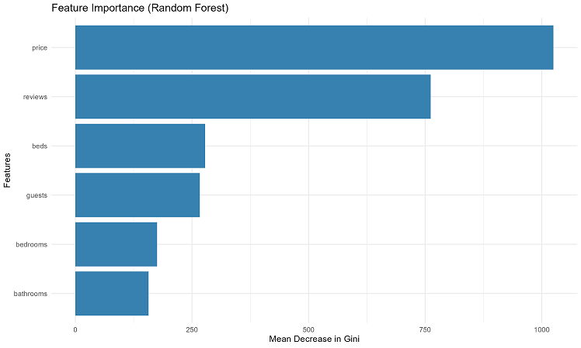
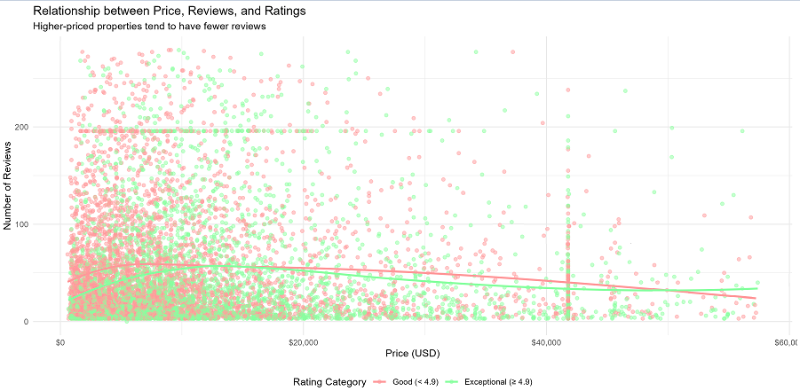
Exploratory Data Analysis
Rating Distribution: Majority of listings fall below 4.9.
Price vs. Rating: High-rated listings typically cost more.
Feature Importance: Price and reviews show strongest correlation with high_rating.
Scatter Plot (Reviews vs Price): High-priced listings tend to have fewer reviews.

Slide 7
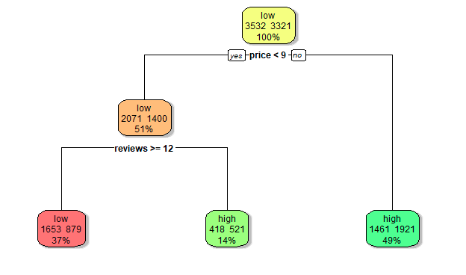
Machine Learning Models
Models used:
Logistic Regression
Decision Tree
Random Forest
Support Vector Machine (SVM)
Naive Bayes
Used 80/20 train-test split and 5-fold cross-validation.
Performance metrics:
Accuracy
Precision
Recall
F1 Score
AUC (Area Under the Curve)
Used caret, randomForest, e1071, rpart, pROC packages for modeling.
Decision Tree for Rating Classification
Notes:
"I built and trained five supervised learning models. I used 5-fold cross-validation to avoid overfitting and evaluated models using both threshold-based and probability-based metrics."

Slide 8
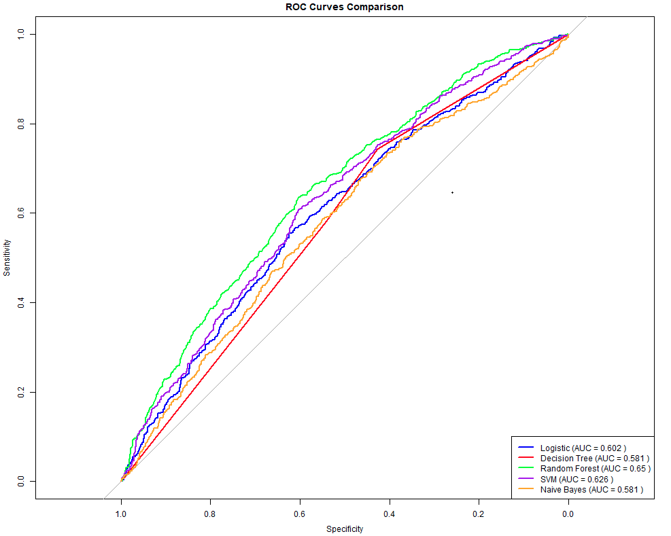
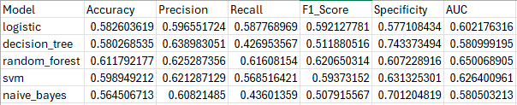
Results and Model Comparison
Random Forest had the best overall performance:
High AUC and accuracy
Balanced F1 score
Logistic Regression offered strong baseline performance with good interpretability.
Decision Tree provided clear visual insights but was prone to overfitting.
ROC curves plotted for visual comparison across all models.
Model_comparison_results

Slide 9
Conclusion & Strategic Takeaways
Key Findings:
Higher price and fewer reviews correlate with higher ratings.
Class imbalance exists most listings are not “exceptional.”
Best Model: Random Forest offered the best accuracy and AUC.
Business Recommendations:
Airbnb could use such models in recommendations.
Hosts could optimize pricing and guest experience for better ratings.

Slide 10


